Slide 1
Biology
Unit 4: Ecosystems: Stability and Change
Lesson 2: Ecosystem Dynamics
Notes:
The learning experiences in this unit prepare students for the mastery of
Performance Expectations
LS1-2 Develop and use a model to illustrate the hierarchical organization of interacting systems that provide specific functions within multicellular organisms.
LS1-3 Plan and conduct an investigation to provide evidence that feedback mechanisms maintain homeostasis.
ETS1-2 Design a solution to a complex real-world problem by breaking it down into smaller, more manageable problems that can be solved through engineering.
ETS1-3 Evaluate a solution to a complex real-world problem based on prioritized criteria and trade-offs that account for a range of constraints, including cost, safety, reliability, and aesthetics, as well as possible social, cultural, and environmental impacts.

Slide 2

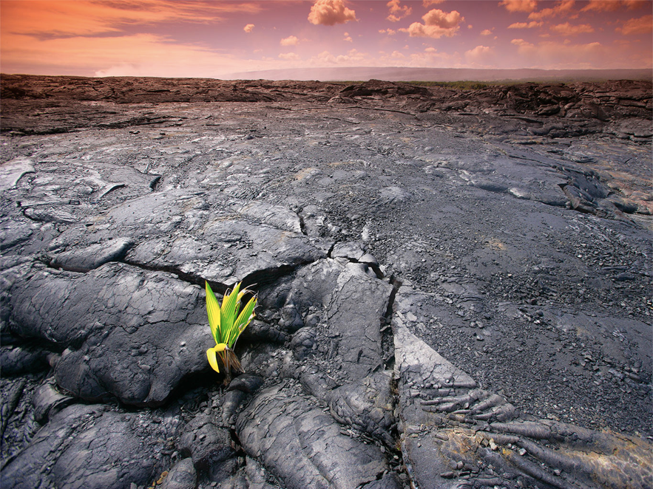
Can You Explain It?
Unit 4 Lesson 2
How do you think an ecosystem can be reestablished in an area after a disturbance such as a volcano?
A young plant grows in a crack in a sheet of bare volcanic rock
Notes:
Build on Prior Lessons
In Lesson 1, students learned about population dynamics. Lesson 2 builds on these concepts as students explore changes in ecosystems and the effects of these changes on populations.
Lesson Objective
Use mathematical representations to analyze and explain how changes in ecosystems affect ecosystem stability.

Slide 3

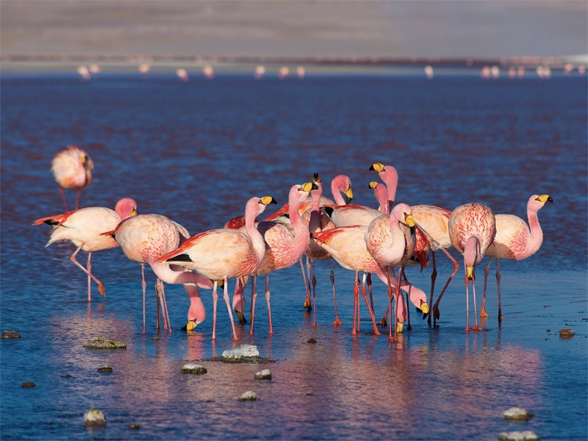
Unit 4 Lesson 2
Interactions in Ecosystems
A habitat includes all of the biotic and abiotic factors in the environment where an organism lives.
Flamingos live and feed in large groups
MODEL:
Draw a model of your habitat. Think of all the places that you regularly visit and the people you interact with, and include those in your model.

Slide 4
Unit 4 Lesson 2
Interactions in Ecosystems
An ecological niche contains all the physical, chemical, and biological factors that a species needs to survive and reproduce.
Food sources :The type of food a species eats, how a species competes with others for food, and where it fits in the food web are all part of a species' niche.
Abiotic conditions: A niche includes the range of conditions such as air temperature and amount of water that a species can tolerate.
Behavior : The time of day a species is active and where and when it feeds and reproduces also are factors in the niche of a species.

Slide 5
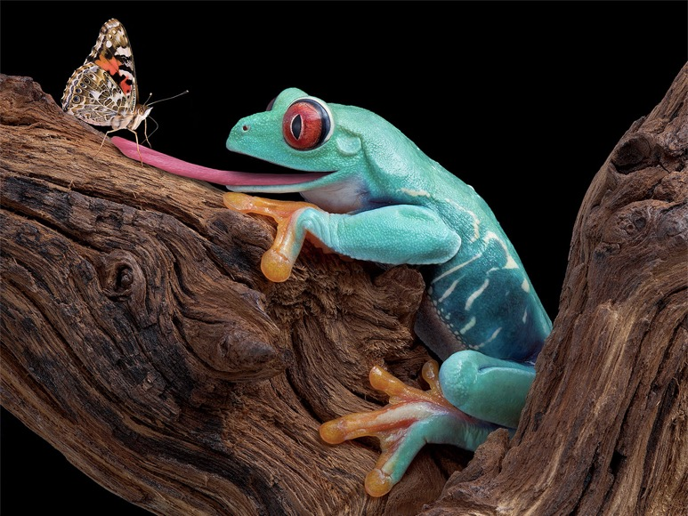
Unit 4 Lesson 2
Interactions in Ecosystems
Predation is the process by which one organism, the predator, captures and feeds upon another organism, the prey.
The frog is the predator in this relationship
MODEL:
Draw a model of your habitat. Think of all the places that you regularly visit and the people you interact with, and include those in your model.

Slide 6
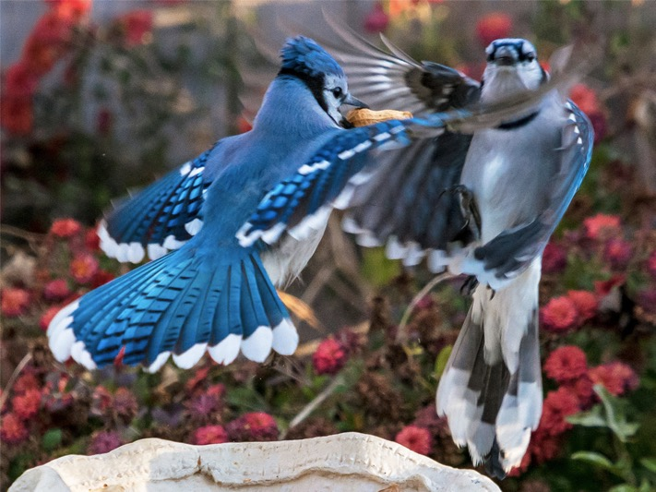
Unit 4 Lesson 2
Interactions in Ecosystems
Competition occurs when two organisms compete for the same limited resource, be it food, shelter, water, space, or any other biotic or abiotic factor that both organisms need to survive
Two blue jays compete for a food source
COLLABORATE
With a partner, think of at least two reasons why an organism might compete with another organism of the same species for a limited resource. Explain why two organisms would compete for these limited resources rather than share them.

Slide 7
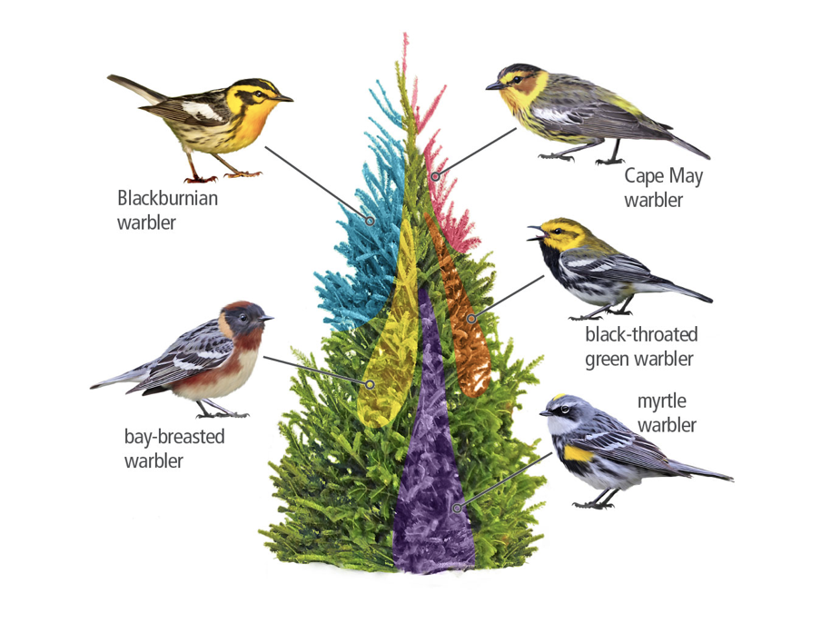
Unit 4 Lesson 2
Interactions in Ecosystems
Stability and Change
ANALYZE:
1. What does this diagram show, and how does it relate to the competitive exclusion principle?
2. Suppose the tip of the spruce tree was broken off during a windstorm. How might the birds be affected by the loss of the uppermost niche in the tree?

Slide 8
Unit 4 Lesson 2
Interactions in Ecosystems
Symbiosis is a close ecological relationship between two or more organisms of different species that live in direct contact with one another.
Mutualism occurs when both species benefit from the relationship.
Commensalism is a relationship between two organisms in which one organism receives an ecological benefit from the other, while the other neither benefits nor is harmed.
Parasitism is a relationship in which one of the organisms benefits while the other one is harmed.
EXPLAIN
How might symbiosis help the stability of an ecosystem?
How might it hurt ecosystem stability?

Slide 9
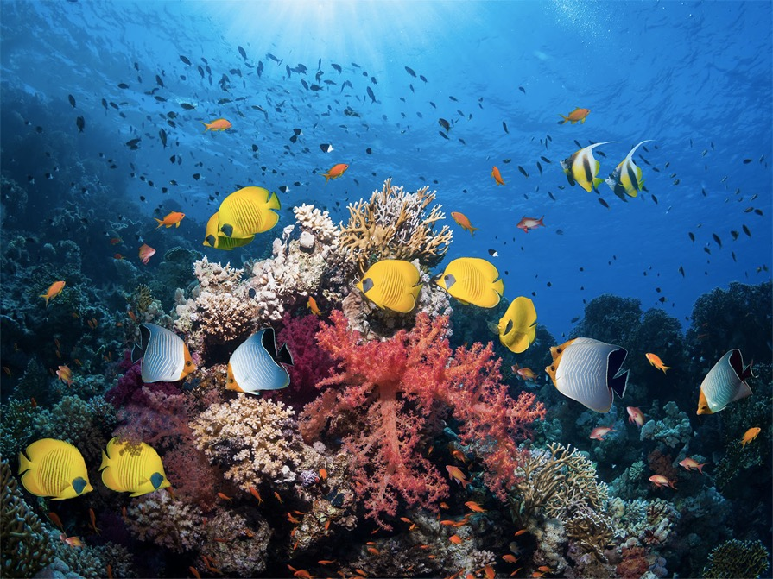
Unit 4 Lesson 2
Biodiversity in Ecosystems
Coral reefs are marine ecosystems where many different species live.
Biodiversity refers to the variety of species within an ecosystem

Slide 10
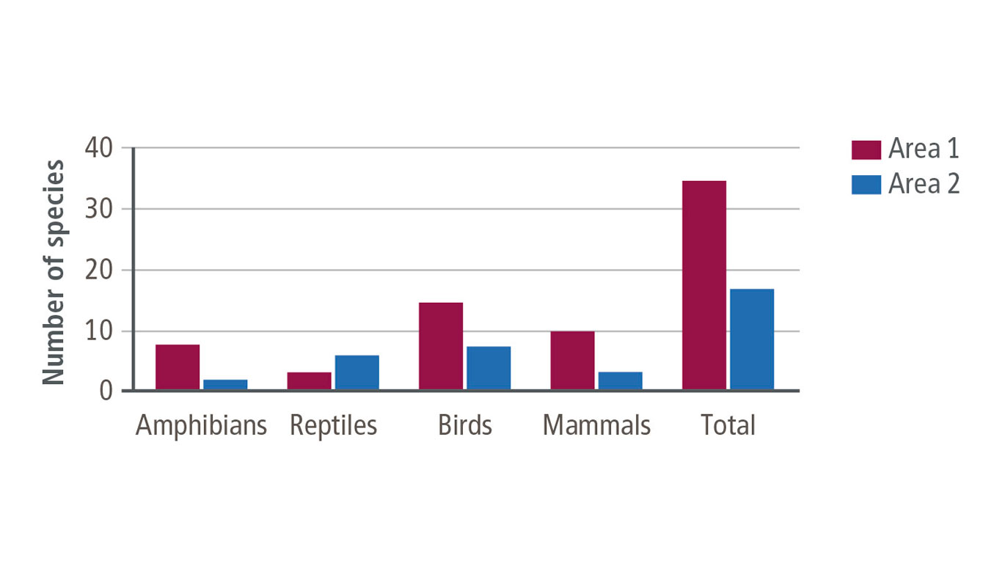
Unit 4 Lesson 2
Interactions in Ecosystems
Data Analysis
Comparison of Species Richness in Area 1 and Area 2

Slide 11
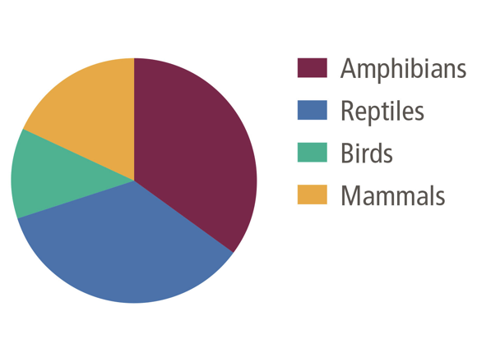
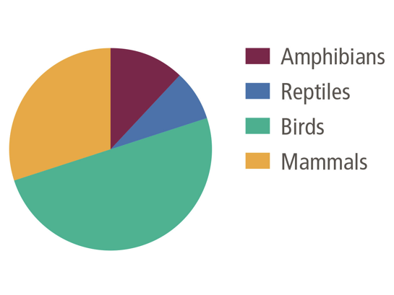
Unit 4 Lesson 2
Interactions in Ecosystems
Data Analysis
Area 1 Species Evenness
Area 2 Species Evenness
How might the arrival of a new species in Area 1 affect the area's species richness and species evenness?

Slide 12
Biodiversity in Ecosystems Engineering
Unit 4 Lesson 2
What is the relationship between biodiversity and ecosystem stability?
How do artificial reefs affect a marine ecosystem's stability?

Slide 13
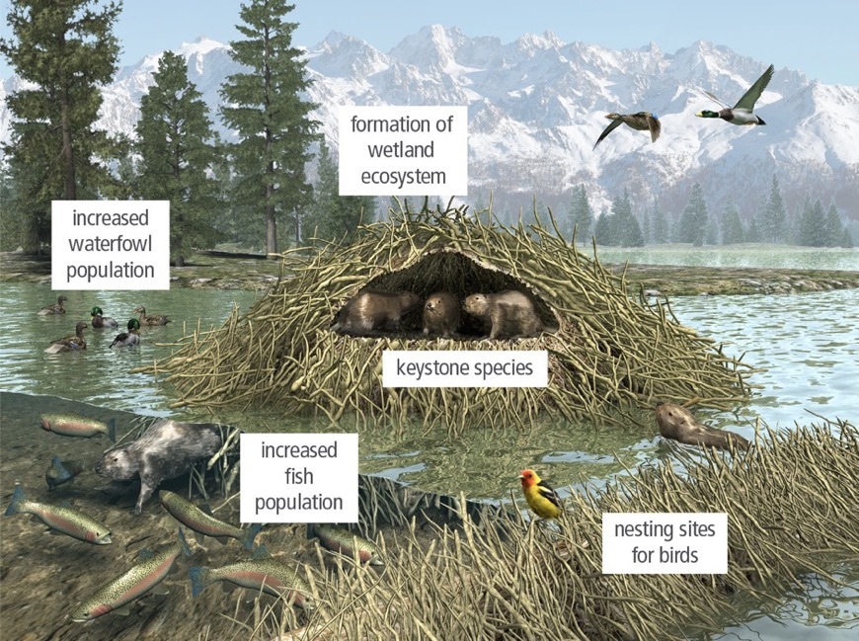
Biodiversity in Ecosystems
Unit 4 Lesson 2
Beavers are a keystone species that make and maintain pond ecosystems.
COLLABORATE
With a partner, discuss why protecting a keystone species can protect a habitat as a whole.

Slide 14
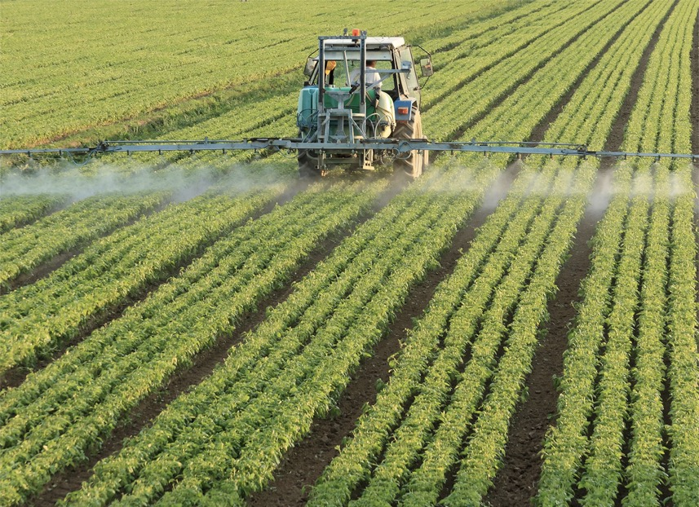
Biodiversity in Ecosystems
Unit 4 Lesson 2
Many farmers use pesticides to control insects and weeds to increase the amount of harvested crops.
EXPLAIN
How does a natural phenomenon, such as the eruption of a volcano on a volcanic island, affect biodiversity?
Will the biodiversity that returns to the island be the same as it was before?

Slide 15
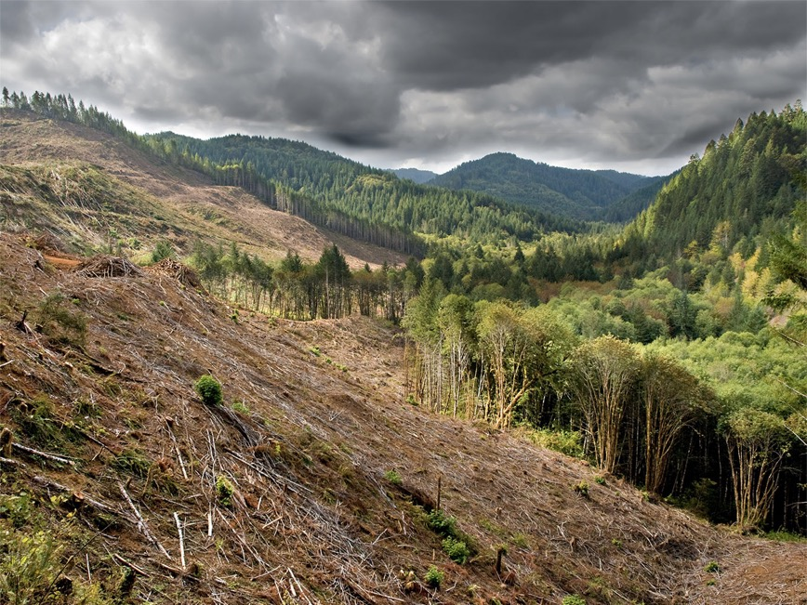
Disturbances in Ecosystems
Unit 4 Lesson 2
Human-Caused Disturbance:
Clear-cutting a forest means removing all the trees.
COLLABORATE
With a partner, discuss why foresters might choose to clear-cut a forest rather than use another method to get wood for human needs. What are the pros and cons of clear-cutting?

Slide 16
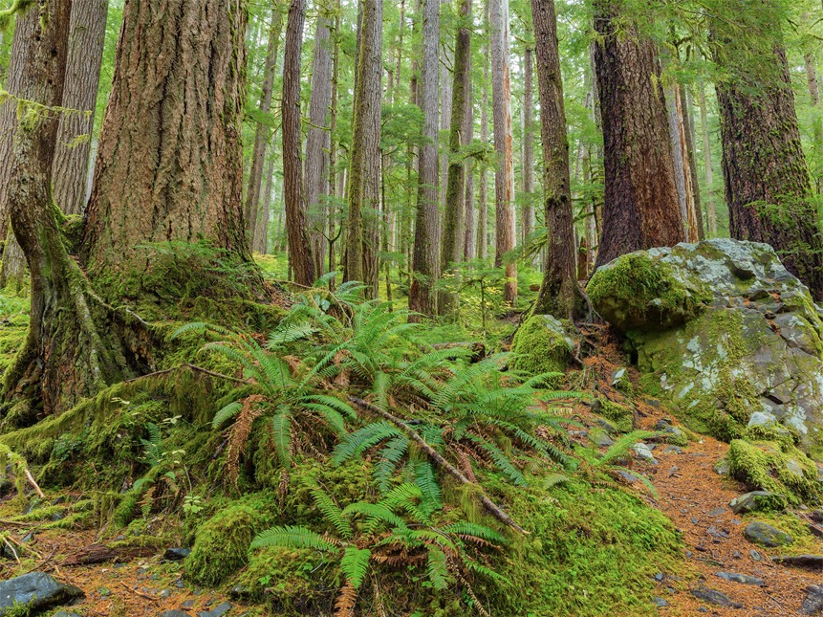
Disturbances in Ecosystems
Unit 4 Lesson 2
This old-growth forest has been stable for many years.
GATHER EVIDENCE
Old-growth forests have remained undisturbed for hundreds of years or more. From what you see in the photo above, what are some characteristics of a stable ecosystem?

Slide 17

Disturbances in Ecosystems Hands-On Lab: Simulating Fire in a Forest Ecosystem
Unit 4 Lesson 2
How might prescribed burns be used to manage the biodiversity in a forest, including threatened or endangered species?

Slide 18
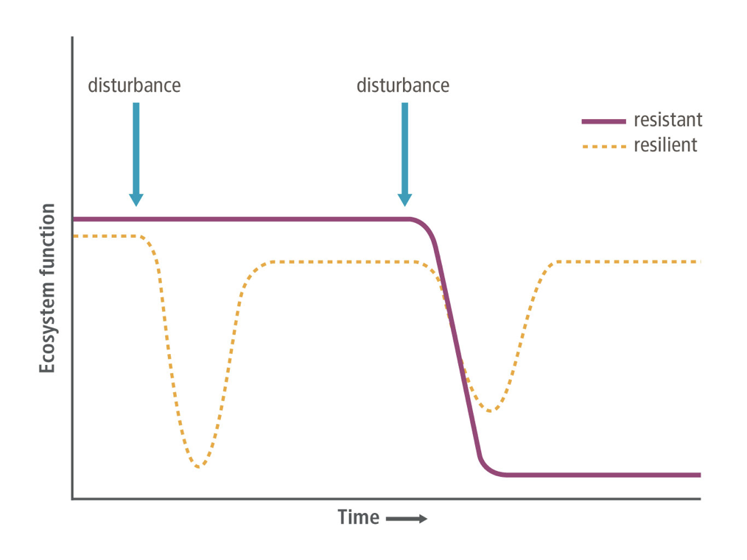
Disturbances in Ecosystems
Unit 4 Lesson 2
This graph shows a simplified version of how ecosystem function might respond to disturbances in resistant versus resilient ecosystems.

Slide 19
Disturbances in Ecosystems
Unit 4 Lesson 2
Resilience as the ability of an ecosystem to recover after it has undergone a disturbance.
Resistance is the ability of an ecosystem to resist change from a disturbance.
EXPLAIN
Think back to the volcanic eruption on the island. Once the lava cooled, plants began to grow.
Is this an example of a stable ecosystem? Use evidence from the discussion of resilient and resistant ecosystems to support your answer.

Slide 20
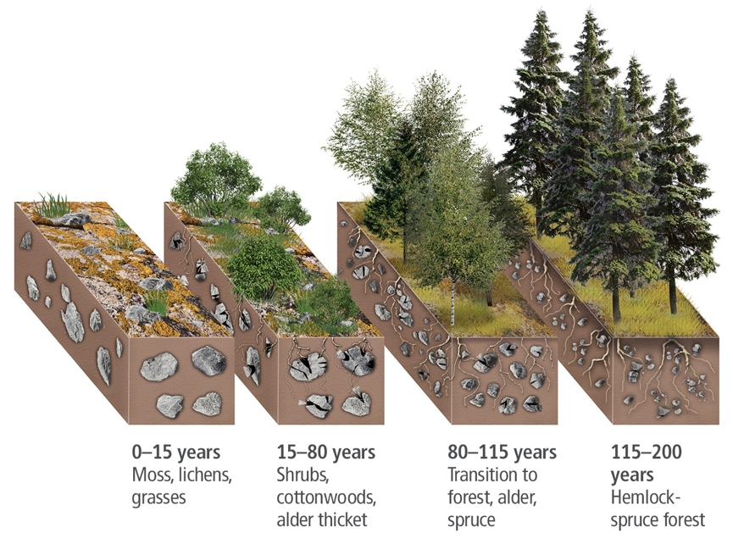
Ecological Succession
Unit 4 Lesson 2
Ecological succession is the sequence of biotic changes that restore a damaged community or create a community in a previously uninhabited area.
Primary Succession is the establishment and development of an ecosystem in an area that was previously uninhabited.

Slide 21
Ecological Succession Hands-On Lab: Using GPS in Ecological Surveys
Unit 4 Lesson 2
Perform a survey by collecting and recording samples of plant life from a given area of land. Find and map their exact location using GPS, and analyze the data.

Slide 22
Unit 4 Lesson 2
Ecological Succession
MODEL
Make a model that shows the difference between primary and secondary succession.
Make sure your model explains how long each step takes and why.

Slide 23
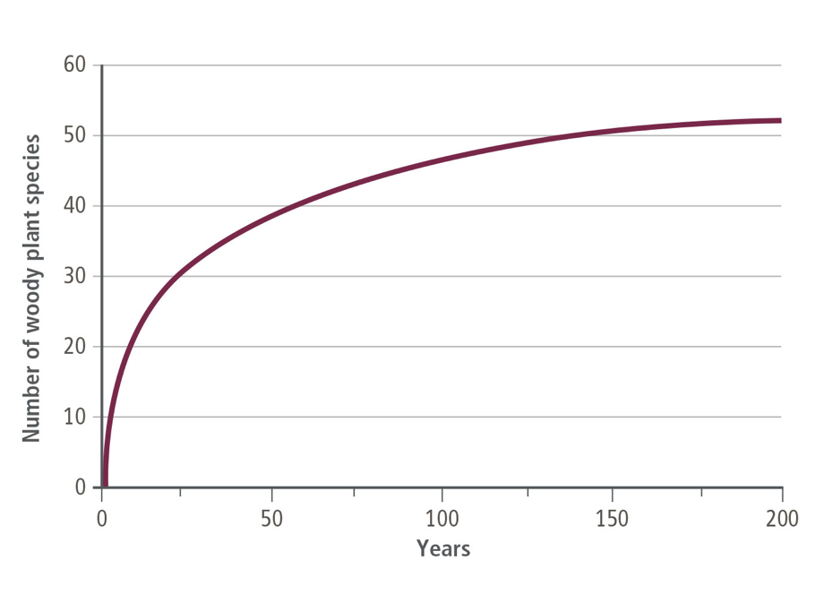
Unit 4 Lesson 2
Ecological Succession
Data Analysis
Species Richness Over Time: The amount of species richness in an ecosystem is related to its stage of succession.
When does species richness increase at the fastest rate? Why is this possible?
Why does the species richness not continue to rise over time? Explain.

Slide 24
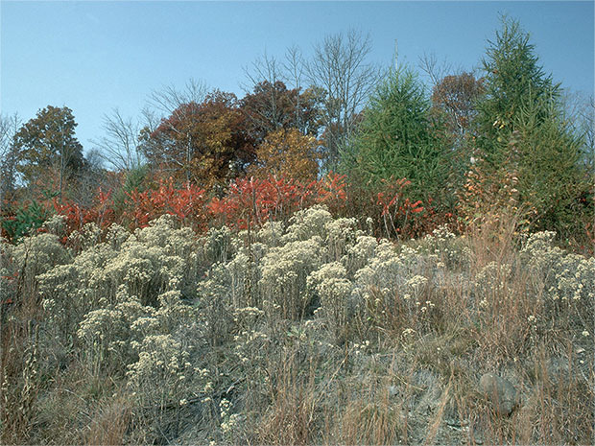
Ecological Succession
Unit 4 Lesson 2
How does ecological succession affect biodiversity?

Slide 25
Unit 4 Lesson 2
Continue Your Exploration
Choose one of the paths below to continue your exploration:
Case Study: Secondary Successions at Mount St Helens
Research: Should Forest Fires Be Suppressed
Succession in Different Ecosystems
The Key(stone) to Ecosystem Stability

Slide 26

Can You Explain It?
Unit 4 Lesson 2
Refer to the notes in your Evidence Notebook and use what you learned in the lesson about succession to explain how a plant is able to grow in the middle of a lava field.

Slide 27
Image Credits
Unit 4 Lesson 2
sideoats grass ©Patrick J. Alexander/U.S. Dept. of Agriculture USDA Photography Center; cottontail rabbit ©Robert Harding World Imagery/James Hager/Getty Images; gray wolf ©SBTheGreenMan/iStock/Getty Images Plus; two blue jays ©RooM/10kPhotography/Getty Images; frog catching butterfly ©Cathy Keifer/Shutterstock; coral reef ©Photographer's Choice/Georgette Douwma/Getty Images; tractor spraying ©Federico Rostagno/Shutterstock; lava rock, plant ©Design Pics/Getty Images; lava rock, plant ©Design Pics/Getty Images; rainforest ©Zhukova Valentyna/Shutterstock

